Slide 1




Digital Forensic
by Himanshu Joshi
Cyber Security Expert
Himanshu Joshi
hckrhimanshu
+91-8669140190

Slide 2

WHO AM I ?
Cyber Security Trainer
Cyber Security Researcher
Digital Forensic Expert
Learn Ethical Hacking Tips
110 + Workshop / Seminars
1500+ Cyber Case Solve
Cyber Crime Investigator
hckrhimanshu
Himanshu Joshi
+91-8669140190

Slide 3

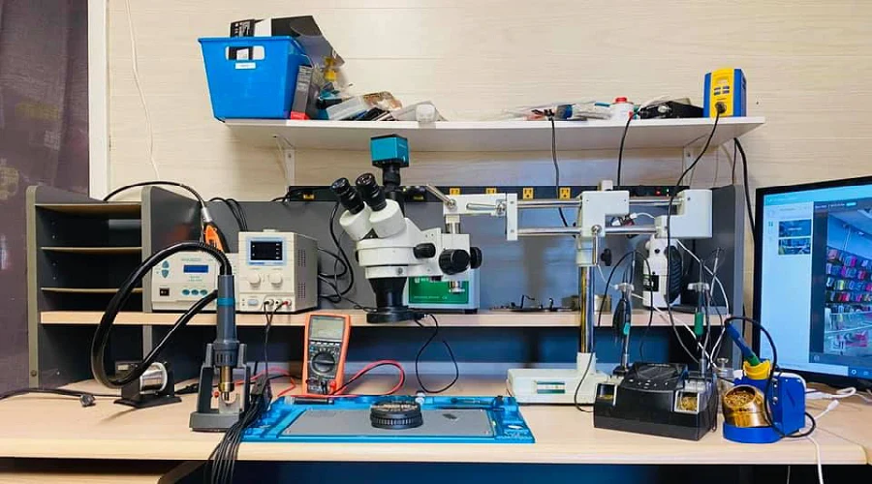
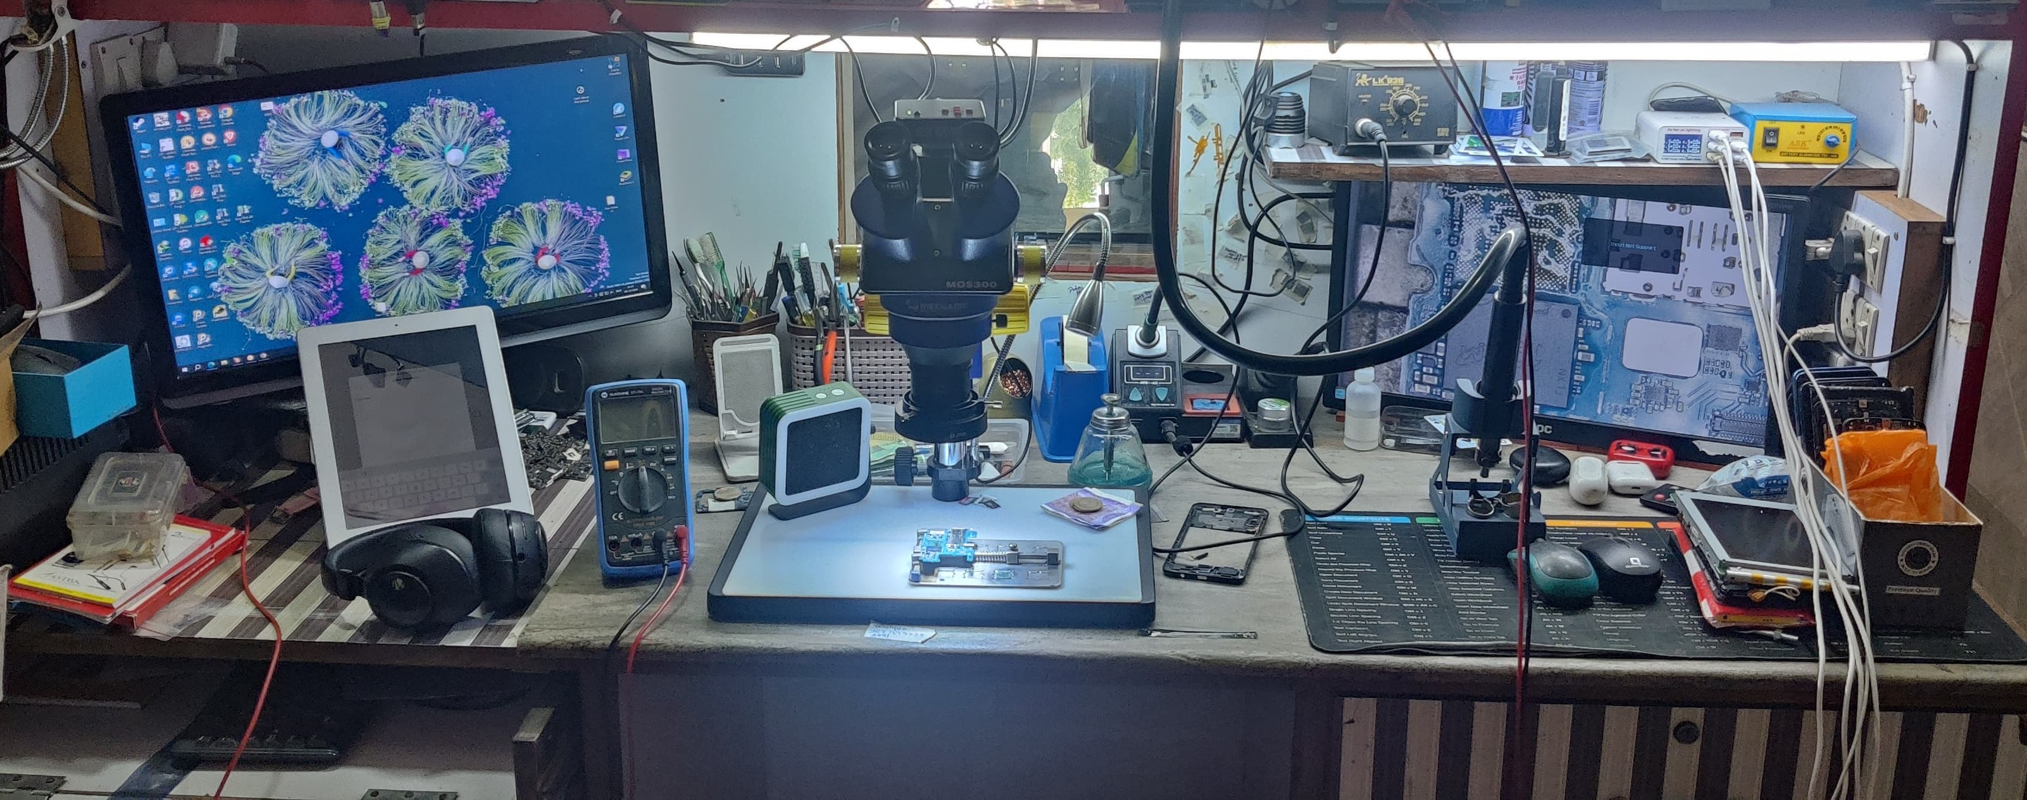

Digital Forensic LAB

Slide 4
THE DATA
DATA IS NEW “GOLD”

Slide 5
What is Digital Forensics?
Definition:
The process of uncovering and interpreting electronic data
Importance:
Helps in solving cybercrimes and legal investigations
Scope:
Applies to computers, networks, mobile devices, cloud systems
Digital Forensic is a field within forensic science that focuses on recovering, analyzing, and preserving digital evidence from electronic devices. It is often used in criminal investigations, cybersecurity incidents, and legal proceedings.

Slide 6
Digital Forensics Process
1. Identification
2. Preservation
3. Collection
4. Examination
5. Analysis
6. Documentation
7. Presentation

Slide 7
Types of Digital Forensics
Computer Forensics (Memory Forensics)
Mobile Device Forensics
Network Forensics
IoT & Drone Forensics

Slide 8
Computer Forensics
Tool | Type | Key Features
Autopsy / Sleuth Kit | Free & Open Source | File recovery, timeline analysis, keyword search, email analysis.
EnCase Forensic | Commercial | Industry-standard tool for imaging, analysis, and court reporting.
FTK (Forensic Toolkit) | Commercial | Data carving, file decryption, registry analysis, fast indexing.
X-Ways Forensics | Commercial | Lightweight, advanced forensic suite with disk imaging and analysis.
CAINE Linux | Open Source OS | Live forensic OS with tools like Autopsy, Volatility, etc.
DEFT Linux | Open Source OS | Ubuntu-based live forensic toolkit used by law enforcement.
Magnet AXIOM | Commercial | Supports computer + mobile forensics; cloud and artifact analysis.
ProDiscover Forensics | Commercial/Free Version | Imaging, recovery, metadata analysis.

Slide 9
Specific Use Tools
🧠 Memory Forensics
Volatility (Free): Best tool for analyzing RAM dumps (Windows, Linux).
Rekall (Free): Also used for memory acquisition and forensic analysis.
📁 File System & Metadata Analysis
Bulk Extractor (Free): Extracts email, credit card data, URL history from disk images.
ExifTool (Free): Analyzes metadata in images, documents, and media files.
🛠️ Disk Imaging Tools
FTK Imager (Free): Used to create forensic disk images.
Guymager (Linux): Open-source imaging tool with hash verification.
🧮 Registry & Log Analysis
RegRipper (Free): Extracts and parses Windows registry hives.
Log2Timeline / Plaso (Free): Creates timelines from log files and artifacts.
🌐 Network/Internet Activity Analysis
Wireshark (Free): Network packet capture and protocol analysis.
Browser History Examiner (Free): Extracts and visualizes browser data.

Slide 10
Best Forensic OS Tools for Police Use
OS Tool | Key Features | Ideal Use
CSI Linux | Complete investigation platform: forensics, OSINT, crypto tracing, memory & malware analysis | Police cyber cells, advanced investigations
SIFT Workstation (by SANS) | Professional-grade forensic suite; timeline, disk, memory & file system forensics | Incident response & digital evidence analysis
CAINE Linux | GUI-focused, beginner-friendly forensic OS with tools like Autopsy, Sleuth Kit, Volatility | Field investigations, court-presentable evidence
DEFT Linux | Pre-configured forensic distro with disk imaging, analysis & mobile forensics tools | General forensic analysis & triage
Tsurugi Linux | Advanced forensic & malware analysis suite, used in cybercrime units | Deep malware, memory & mobile device analysis
Paladin Forensic Suite | USB-based forensic OS with disk imaging, file carving, password recovery tools | On-site data collection and first responder kits
Kali Linux (Forensics Mode) | Comes with Autopsy, Volatility, Binwalk, etc. | When combined with offensive cybersecurity investigations

Slide 11
Mobile Device Forensic
Tool | Key Features | Platforms
Cellebrite UFED | Industry-leading tool for data extraction, decoding, and analysis from smartphones and cloud. | Android, iOS, feature phones
Magnet AXIOM | Extracts mobile, computer, and cloud data; creates timelines and visualizations. | Android, iOS
Oxygen Forensics Detective | Accesses device data, cloud services, and apps; supports drone data and IoT. | Android, iOS
MSAB XRY | Secure tool used by police to extract and decode data from mobile devices. | Android, iOS, GPS, SIM
Elcomsoft iOS Forensic Toolkit | Extracts full file system and keychain from iPhones and iPads. | iOS only
MOBILedit Forensic Express | Data extraction and reporting; includes malware detection and timeline analysis. | Android, iOS, Windows Phone
ADF Mobile Device Investigator (MDI) | Quick triage of digital evidence from mobile devices in the field. | Android, iOS
Paraben Device Seizure | Comprehensive mobile acquisition and analysis tool. | Android, iOS, feature phones

Slide 12
Data Recocery Free Tool For Android
Tool | Features | Notes
DiskDigger (for Android) | Recover deleted photos and images from internal storage or SD card. | Available on Google Play; root access recommended for deep scan.
Dr.Fone - Data Recovery (Free Trial) | Recover contacts, messages, call logs, photos. | Limited recovery in free version.
Tenorshare UltData for Android | Recovers WhatsApp, photos, and messages. | Free version allows preview; recovery is limited.
iMobie DroidKit (Free) | Recovers deleted data without root, works on corrupted Android systems. | Some features locked behind paywall.
PhotoRec (open-source) | Recovers a wide range of file types from Android SD cards. | Command-line interface; best for advanced users.

Slide 13
Data Recovery For IOS / Apple
Tool | Features | Notes
EaseUS MobiSaver Free for iOS | Recover contacts, messages, photos, videos. | Limited free version, preview available.
PhoneRescue for iOS (Free Trial) | Recovers 25+ types of data including WhatsApp and SMS. | Free to scan and preview.
Dr.Fone - iOS Recovery (Free) | Extracts data from device or iCloud/iTunes backups. | Recovery requires purchase, preview is free.
iTunes Backup Restore (manual) | If backups exist, data can be recovered for free. | No third-party software needed.

Slide 14
Network Forensic
What is Network Forensics?
The practice of intercepting, recording, and analyzing network packets to trace malicious activity, data exfiltration, unauthorized access, or policy abuse.
What You Can Investigate
Suspicious IP communications
Unauthorized data transfer
Malware behavior (via command & control communication)
VoIP session reconstruction
Email, web, and chat session monitoring
Downloaded files (from HTTP, FTP)
DNS tunneling, lateral movement, etc

Slide 15
Network Forensic Tool
Tool | Type | Description
Wireshark | Free | Packet analyzer that captures and inspects real-time network traffic. Most used in network forensics.
NetworkMiner | Free/Pro | Passive network sniffer that extracts artifacts (e.g., files, credentials) from PCAPs.
Xplico | Free | Reconstructs sessions (emails, VoIP, HTTP) from captured network traffic.
tcpdump | Free (CLI) | Command-line tool for capturing network traffic on Unix-based systems.
Arkime (formerly Moloch) | Free | Open-source, large-scale full-packet capture and indexing system.
NfSen / Nfdump | Free | Used for analyzing NetFlow data from routers/firewalls.
Suricata | Free | Intrusion detection system (IDS) that can capture and log network traffic in real-time.
Bro/Zeek | Free | High-level network monitoring framework that logs connection metadata (DNS, HTTP, SSL).
Security Onion | Free OS | A Linux distro with Zeek, Suricata, Wazuh, Kibana—complete network forensic & SIEM suite.

Slide 16
IoT & Drone Forensics
What Is IOT Forensics ?
IoT forensics involves collecting and analyzing data from smart devices (CCTV, smartwatches, smart home hubs, medical devices, etc.) that are connected to the internet and interact with their environment
IOT full form Internet Of Things.
Common IoT Devices in Forensics
Smartwatches (e.g., Apple Watch, Fitbit)
Smart speakers (Amazon Echo, Google Home)
IP/CCTV Cameras
Smart TVs
Smart locks and doorbells (Ring, Nest)
Smart appliances (fridges, thermostats)
Connected vehicles (Telematics data)

Slide 17
IOT Forensic Tool
Tool | Use
Autopsy + IoT Modules | Analyze extracted storage from IoT hubs
Wireshark / Zeek | Capture and analyze IoT network communication
FTK / X-Ways | Analyze IoT firmware images and local storage
Firmware Analysis Tools: Binwalk, IDA Pro, Ghidra | Reverse-engineer IoT firmware
IoT Inspector (firmware security) | Analyze vulnerabilities and data leaks
Cloud Forensics Tools | Access synced IoT data (Alexa, Google Home)
Router Logs / DHCP logs | Track IoT device connections on networks

Slide 18
Drone Forensic
What Is Drone Forensic ?
Drone forensics focuses on analyzing UAV devices (like DJI drones) to extract flight logs, media, GPS tracks, and communication data that can act as digital evidence.
Data Acquired from Drones
Flight logs (locations, altitude, time)
Media (photos, videos, audio)
GPS coordinates
Controller IDs
Wi-Fi and telemetry data
Crash reports
Payload deployment info

Slide 19
Drone Forensic Tool
Tool | Function
DJI Flight Log Viewer / CSVtoKML | Visualize DJI drone flight paths in Google Earth
Autel Explorer App Data Viewer | Parses logs from Autel drones
OpenDroneMap | Processes images and 3D mapping
Airdata UAV | Online log analysis for multiple drone types
EXIFTool | Extract metadata from drone photos and videos
UAV Log Viewer | Analyze raw logs from drone storage
BlackBox Extractor | Extract internal logs from DJI drones
Cloud-based tools (DJI Cloud, Parrot Cloud) | Access synced flight data (requires legal access)

Slide 20
Thank You
hckrhimanshu
Himanshu Joshi
+91-8669140190

Slide 21
Digital Forensics Process Overview
Standard methodology to investigate digital evidence
Ensures data integrity, legality, and reproducibility
Used by law enforcement, military, private sector

Slide 22
1. Identification
Recognize incident and identify potential evidence
Define scope: devices, cloud accounts, networks
Examples: suspect's laptop, email logs, USB drives

Slide 23
2. Preservation
Isolate and preserve original data
Use write blockers and hashing (MD5/SHA-1)
Avoid altering evidence during collection

Slide 24
3. Collection
Acquire data from identified sources
Tools: FTK Imager, dd, Cellebrite, Magnet AXIOM
Capture disk images, RAM dumps, cloud data

Slide 25
4. Examination
Apply forensic techniques to uncover data
Recover deleted files, analyze logs, search keywords
Tools: Autopsy, EnCase, Volatility, Wireshark

Slide 26
5. Analysis
Interpret findings to build case narrative
Timeline reconstruction, correlation of artifacts
Identify user actions, malware, data exfiltration

Slide 27
6. Reporting
Document all findings clearly and legally
Include screenshots, logs, hashes, and timelines
Ensure report is admissible in court

Slide 28
Digital Forensics Process – Expert Perspective
Cyber experts emphasize a methodical and repeatable approach:
🔹 **Preparation**: Set up forensic lab, tools, policies
🔹 **Live Analysis**: Examine volatile data when device is running
🔹 **Triage**: Prioritize evidence based on relevance and volatility
🔹 **Chain of Custody**: Maintain strict documentation of evidence handling
🔹 **Validation**: Use hashing, cross-verification with multiple tools
🔹 **Tool Selection**: Choose based on legality, reliability, and target platform
🔹 **Collaboration**: Work with legal, network, and cloud teams

Slide 29
THE IT ACTS
Section 65 IT Act 2000:
Tampering with computer source documents. Three years imprisonment / 2 lakh fine
Section 66 IT Act 2000:
Hacking with computer system.
Three years imprisonment / 5 lakh fine
Section 66B IT Act 2000:
Retrieving a stolen computer or communication device.
Three years imprisonment / 1 lakh fine
Section 66C IT Act 2000:
Using someone else's password.
Three years imprisonment / 1 lakh fine
Section 66E IT Act 2000:
To publish private photos of others.
Three years imprisonment / 2 lakh fine
Section 67A IT Act 2000:
Publish images containing sexual acts.
Seven years imprisonment / 1 lakh fine
Section 66F IT Act 2000:
Acts of cyber terrorism.
Life imprisonment.
Section 70 IT Act 2000:
Unauthorized access to the protected system.
Ten years in prison
Section 72 IT Act 2000:
Breach of privacy.
Two years imprisonment / 1 lakh fine
Section 73 IT Act 2000:
Certificate of electronic signature is publishing incorrectly.
Three years imprisonment / 2 lakh fine

